Slide 1
Regression analysis of apartment prices in Budapest, Hungary
Metis, New York
10.12.2018
Krisztian Sandor

Slide 2
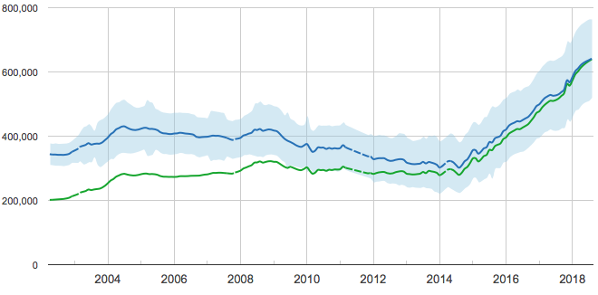
Budapest has one of the cheapest, yet fastest developing housing markets in the EU
One of the cheapest real estate markets in the EU...
Price per m², USD¹
…creates a heavy price growth since 2014
Price per m², USD²
Approximation
3,040
May 2018
Avg. price per m²: 2,904
2,280
1,520
760
Quick facts: Population: 10M in Hun, 2M in Bp || Currency: HUF (~280 HUF/USD) || GDP p. c.: ~15k USD (53rd )
1 Average price of 120 square meter apartments located in the most important cities of countries in EU-28 as of May 2018 2 Converted using 303.5 EUR/HUF and 0.867 USD/EUR for approximate comparison with statista.com data
Source: statista.com, ingatlannet.hu, own analysis

Slide 3
5 step journey to turn ingatlan.com UI into a regression model predicting the apartment price
Major steps of my work:
From an interactive UI to a regression model
Source, scrape the data of ingatlan.com and ingatlannet.hu
Clean & apply one-hot encoding on the features where applicable, e.g. district, orientation, etc.
Fit baseline linear model using SIZE as the independent variable
Add 2nd degree and interaction variables to the model to account for apparent polynomial relationships
Apply LASSO regularization to limit the number of variables generated
Summarize and draw conclusions

Slide 4
5 step journey to turn ingatlan.com UI into a regression model predicting the apartment price
Major steps of my work:
From an interactive UI to a regression model
My target variable:
Price of the apartment has a right tail yet workable
Source, scrape the data of ingatlan.com and ingatlannet.hu
Clean & apply one-hot encoding on the features where applicable, e.g. district, orientation, etc.
Fit baseline linear model using SIZE as the independent variable
Add 2nd degree and interaction variables to the model to account for apparent polynomial relationships
Apply LASSO regularization to limit the number of variables generated
Summarize and draw conclusions

Slide 5
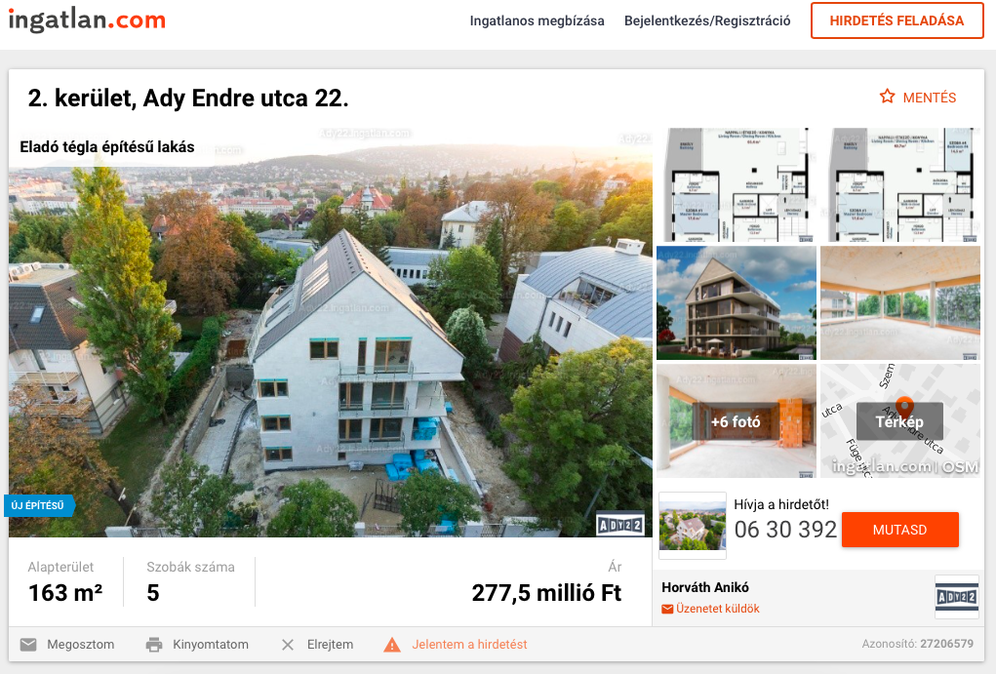
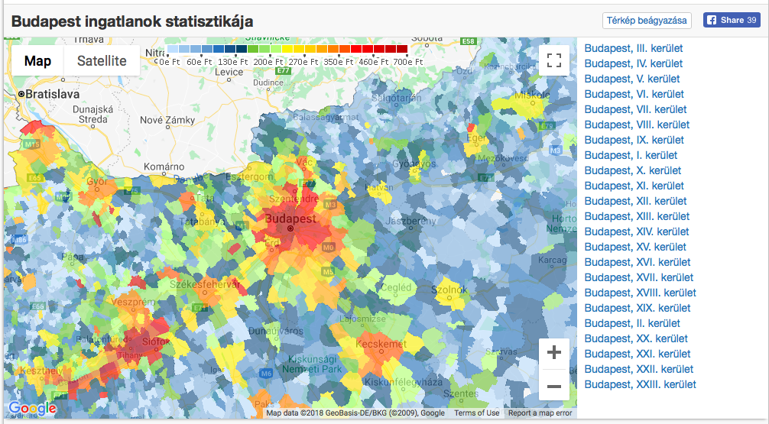
Step 1: Faced numerous challenges, incl. scraping an interactive map, kick-outs, etc.
Major steps of my work:
From an interactive UI to a regression model
The various data sources brought numerous challenges
Source, scrape the data of ingatlan.com and ingatlannet.hu
Clean & apply one-hot encoding on the features where applicable, e.g. district, orientation, etc.
Fit baseline linear model using SIZE as the independent variable
Add 2nd degree and interaction variables to the model to account for apparent polynomial relationships
Apply LASSO regularization to limit the number of variables generated
Summarize and draw conclusions
Ingatlan.com
Ingatlannet.hu
Intro: Biggest real estate aggregator
Scraping: Using beautifulsoup, kick-out timer, useragent randomizer
Cleaning: Hand-typed data, hence heavy cleaning required
Intro: Real estate statistics site Scraping: Using selenium, and regex to access interactive map info
Cleaning: Very clean data, virtually no adjustments required
Source: ingatlan.com, own analysis

Slide 6
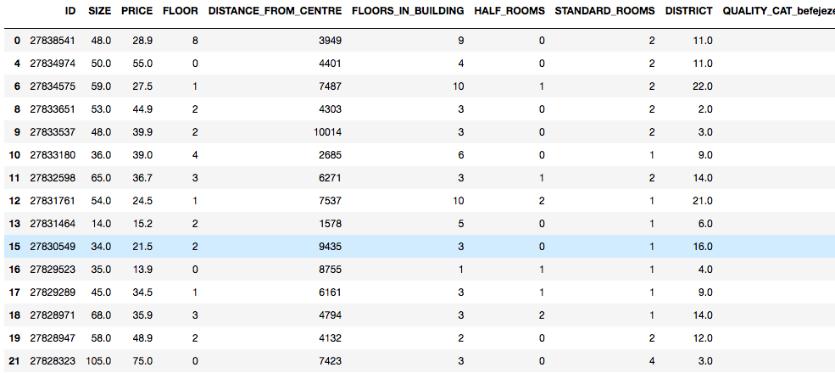
Step 2: Created 70 features from the original 20, raising the chance of overfitting
Major steps of my work:
From an interactive UI to a regression model
One-hot encoding enabled the usage of categorical data
Snippet of real estate dataframe
Source, scrape the data of ingatlan.com and ingatlannet.hu
Clean & apply one-hot encoding on the features where applicable, e.g. district, orientation, etc.
Fit baseline linear model using SIZE as the independent variable
Add 2nd degree and interaction variables to the model to account for apparent polynomial relationships
Apply LASSO regularization to limit the number of variables generated
Summarize and draw conclusions
4861 records cleaned from 252 outliers
70 features, of which 8 numerical, 62 one-hot encoded
Source: ingatlan.com, own analysis

Slide 7
Step 2: Created 70 features from the original 20, raising the chance of overfitting
Major steps of my work:
From an interactive UI to a regression model
One-hot encoding enabled the usage of categorical data
Snippet of real estate dataframe
Source, scrape the data of ingatlan.com and ingatlannet.hu
Clean & apply one-hot encoding on the features where applicable, e.g. district, orientation, etc.
Fit baseline linear model using SIZE as the independent variable
Add 2nd degree and interaction variables to the model to account for apparent polynomial relationships
Apply LASSO regularization to limit the number of variables generated
Summarize and draw conclusions
4861 records cleaned from 252 outliers
70 features, of which 8 numerical, 62 one-hot encoded
What have been identified as outliers?
2+ M HUF PRICE/SQM | 250+ M HUF price | 250+ SQM, 12+ km from the centre | 4+ half rooms | 6+ standard rooms | 1+ relative_floor score
Source: ingatlan.com, own analysis

Slide 8
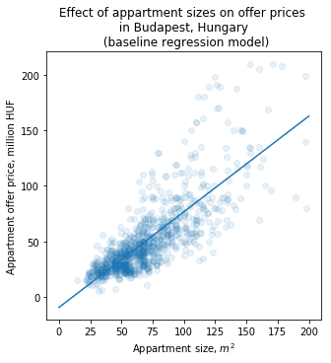
Step 3: Baseline model was already able to explain 64% of the variance in apartment prices
Major steps of my work:
From an interactive UI to a regression model
One-hot encoding enabled the usage of categorical data
Source, scrape the data of ingatlan.com and ingatlannet.hu
Clean & apply one-hot encoding on the features where applicable, e.g. district, orientation, etc.
Fit baseline linear model using SIZE as the independent variable
Add 2nd degree and interaction variables to the model to account for apparent polynomial relationships
Apply LASSO regularization to limit the number of variables generated
Summarize and draw conclusions
R-SQUARED:~64%
RMSE: ~19 million HUF (~67k USD).
Conclusions: SIZE is not the only important factor in predicting the apartment PRICE, and there are numerous optimization factors to be implemented.
Source: ingatlan.com, own analysis

Slide 9
Step 4A: Extended 1st degree model still has strong visible bias in the residual plot
Major steps of my work:
From an interactive UI to a regression model
Extended 1st degree model has better predictive power but still strong visible bias
Source, scrape the data of ingatlan.com and ingatlannet.hu
Clean & apply one-hot encoding on the features where applicable, e.g. district, orientation, etc.
Fit baseline linear model using SIZE as the independent variable
Add 2nd degree and interaction variables to the model to account for apparent polynomial relationships
Apply LASSO regularization to limit the number of variables generated
Summarize and draw conclusions
A
Extended 1st degree model
R-SQUARED:~78%
RMSE: ~16 million HUF (~57k USD).
Conclusions: Clear chance of further improvement given visible bias in regression plot
Source: ingatlan.com, own analysis

Slide 10
Step 4B: Polynomial features provide small R-squared, yet substantial RMSE improvement
Major steps of my work:
From an interactive UI to a regression model
Polynomial features provide small R-squared, yet substantial RMSE improvement
Source, scrape the data of ingatlan.com and ingatlannet.hu
Clean & apply one-hot encoding on the features where applicable, e.g. district, orientation, etc.
Fit baseline linear model using SIZE as the independent variable
Add 2nd degree and interaction variables to the model to account for apparent polynomial relationships
Apply LASSO regularization to limit the number of variables generated
Summarize and draw conclusions
B
Adding 2nd degree and interaction features
R-SQUARED:~80%
RMSE: ~15 million HUF (~53k USD).
Conclusions: 2 p.p. improvement in the R² combined with 1M HUF improvement in the RMSE suggests that the model required polynomial features
Source: ingatlan.com, own analysis

Slide 11
Step 5: LASSO provided a streamlined yet stronger predictive model
Major steps of my work:
From an interactive UI to a regression model
Polynomial features combines with LASSO helped to create a streamlined yet stronger final model
Source, scrape the data of ingatlan.com and ingatlannet.hu
Clean & apply one-hot encoding on the features where applicable, e.g. district, orientation, etc.
Fit baseline linear model using SIZE as the independent variable
Add 2nd degree and interaction variables to the model to account for apparent polynomial relationships
Apply LASSO regularization to limit the number of variables generated
Summarize and draw conclusions
C
LASSO regularization
R-SQUARED:~84%
RMSE: ~13.7 million HUF (~48.4k USD).
Conclusions: 6 p.p. improvement in predictive power and 8.6M improvement in RMSE suggest that the added complexity is offset by model quality
Extra: LASSO decreased the number of features from 1,605 to 197 (incl. interaction and 2nd degree ones)
Source: ingatlan.com, own analysis

Slide 12
Steps 4-5: Pulling it all together, clear predictive improvement and decrease in visible bias
A
B
C
Extended 1st degree model
Adding 2nd degree and interaction features
LASSO regularization
R-SQUARED:~78%
RMSE: ~16 million HUF (~57k USD)
R-SQUARED:~80%
RMSE: ~15 million HUF (~53k USD)
R-SQUARED:~84%
RMSE: ~13.7 million HUF (~48.4k USD)
Source: ingatlan.com, own analysis

Slide 13
Step 6: Size and the district average are most important factors in price prediction
Major steps of my work:
From an interactive UI to a regression model
The 10 most important features almost all have SIZE as an interaction variable
Source, scrape the data of ingatlan.com and ingatlannet.hu
Clean & apply one-hot encoding on the features where applicable, e.g. district, orientation, etc.
Fit baseline linear model using SIZE as the independent variable
Add 2nd degree and interaction variables to the model to account for apparent polynomial relationships
Apply LASSO regularization to limit the number of variables generated
Summarize and draw conclusions
Observations:
Size is very relevant, and is present as interaction in almost all factors
District averages, panoramic views, overall quality, and year built matter for finding the right price
Source: ingatlan.com, own analysis

Slide 14
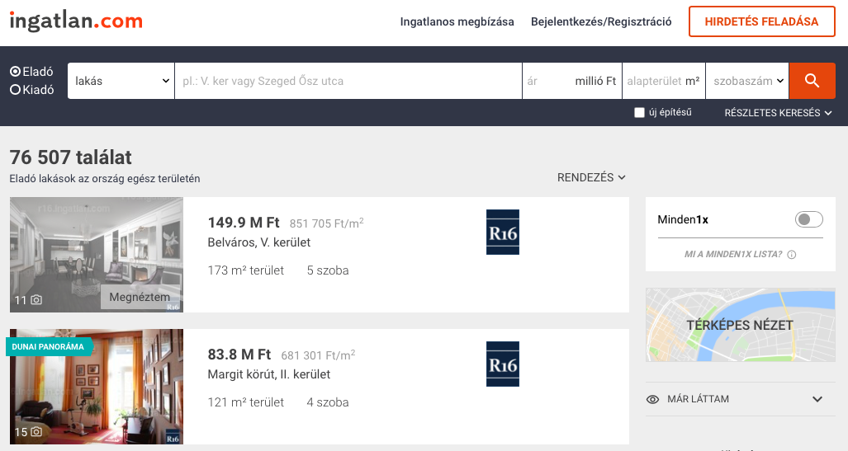
A predictive apartment pricing model has a clear business applicability on ingatlan.com
Adding a real estate price estimator to the advertiser and customer journeys of ingatlan.com…
… would would bring numerous advantages to both ingatlan.com and the market
What is my apartment worth?
What is my apartment worth?
A button could be placed to the main page of ingatlan.com…
Calibrate people attitude to high real estate prices and help drive attention towards realistic options
…which leads to a landing page with a form to fill in of the the apartment…
Limit unfairly high or low listing prices stemming from lack of market knowledge, hence easing the selling process
…which runs the predictive model and returns the approximate ‘fair’ price
Source: ingatlan.com, google images

Slide 15
Thank you!

